Slide 1
CREATING PUBLIC ART:
THE PROCESS BEHIND THE PRODUCT
Fractal Tree Archway and Endless

Slide 2
Fractal Tree Archway
Paul Sorey

Slide 3
Concept & Imagery
Two stainless steel fractal trees create an archway “entrance” to both the new Science Building and the future quad area of campus. The two trees will be visible from the street. Their scale is large enough to complement the building. The space between the trees and under their canopy, however, is of pedestrian scale; thus the artwork serves to bridge the scale of people to the scale of the building.
The trees are a natural form and refer to nature. The trees are made of stainless steel and put together with nuts and bolts; a reference to human interaction with nature.
The branching structure is a fundamental structure that underlies many natural forms and phenomena. The fractal nature of the trees, where each part of the tree is an identical copy of the other parts, scaled and rotated in space, is a mathematical concept that underlies the structure of many forms in nature. The extent to which fractal organization underlies natural phenomena is not clearly understood, and is an area of continuing research in mathematics and the sciences.
ARTWORK CONCEPT & IMAGERY — ARTIST’S PROPOSAL

Slide 4
Artwork Description
The trees are each 17 feet tall and 20 feet wide (refer to attached drawings). A 5-foot wide section of special paving to match that used at the building entry will span the sidewalk between the trees. The College has agreed to install the concrete footing and the special paving.
The tree grates will be made of ½-inch thick stainless steel plate, 3 to 4 feet square, cut with a pattern yet to be determined. The tree grate will be held in place by a stainless-steel tree-grate frame, fastened to the footing slab.
The tree grate will be designed to meet ADA standards.
Materials used for the trees and tree grates will be type 304L stainless-steel plate and fasteners. The exposed portions of the stainless steel will have a grinder finish to pick up light from different directions. The stainless will be uncoated.
The College has also agreed to provide four uplights near the sidewalk for illuminating the trees at night. These could be standard metal-halide lamps or LED lamps.
ARTWORK DESCRIPTION — ARTIST’S PROPOSAL

Slide 5
Installation
The College's contractor will provide the concrete footing as part of site construction. The college will notify the Artist several days before the footing is poured for coordination between the Artist and the College's contractor. Once the footing is installed, the Artist will install two stainless-steel tree-grate frames. The College's contractor will then install the special paving over the footing slab.
The Artist will install the tree grates into the frames before the building opens in the fall of 2009. The installation of the tree artwork will occur before April 2010.
During installation of the tree artwork, the trees will be assembled in place at the site. The bottom section will be bolted to the concrete footing with epoxy-set anchor bolts, and the rest will be bolted section-by-section to the base, probably with the aid of a man-lift or cherry-picker. The bolts will be spot welded to prevent tampering.
The structural engineering for the trees will accommodate the possibility of the trees being climbed. Climbing will be discouraged because of the smooth metal surface of the trees. The protruding bolts and mounting brackets could provide hand- and foot-holds, but are not expected to be easy to use in this manner.
INSTALLATION PLAN — ARTIST’S PROPOSAL

Slide 6
Maintenance
Type 304 stainless steel will maintain a bright, reflective finish for many years. Every few years, depending on need, the trees could be washed with mild detergent (dish soap) and sponge to remove dirt and grease. Some tarnishing with age and finger oils is to be expected. The tarnish is actually a layer of protective oxides that keep the surface from corroding. Graffiti can be removed with detergent, mineral spirits or paint remover without damaging the finish.
For long-term maintenance (after 10 to 20 years), the tree structures should be checked for corrosion, which should be removed by grinding or acid-etching. Weld metal can be added if weakening of joints is noted.
Timeline
Stamped Drawings March 2009
Purchase Materials April 2009
50% completion September 2009
Permits (not required)
100% completion March 2010
Installation March 2010
MAINTENANCE & TIMELINE — ARTIST’S PROPOSAL

Slide 7
Skagit Valley College Artwork
Washington State Arts Commission
Fabrication Budget
Fabrication
Materials
stainless steel + hardware $12,000.00
miscellaneous supplies $5,000.00
Labor $30,000.00
Subconsultants
structural engineer $1,500.68
Installation
Labor $2,200.00
Truck Rental $500.00
Subcontractors
man lift + operator $5,000.00
Plaque $400.00
Other Costs
Permits $300.00
Documentation $500.00
Public Event $200.00
Insurance $780.00
Contingency $6,421.87
Artist's fee $6,480.26
State Sales Tax (8.2%) $5,845.19
Total $77,128.00
FABRICATION BUDGET — ARTIST’S PROPOSAL

Slide 8
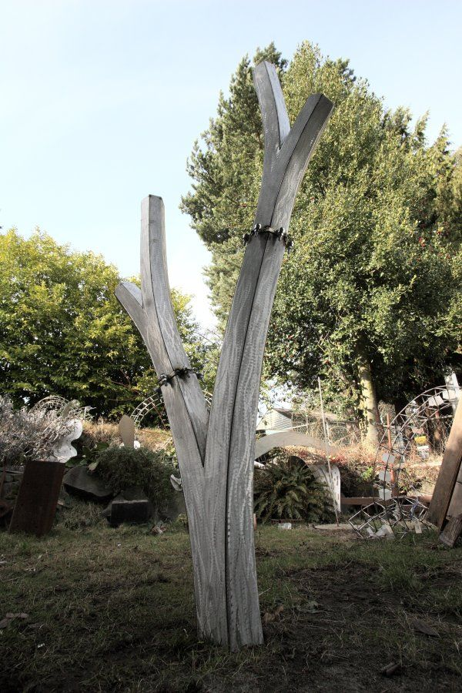
ARTIST’S PROTOTYPE

Slide 9
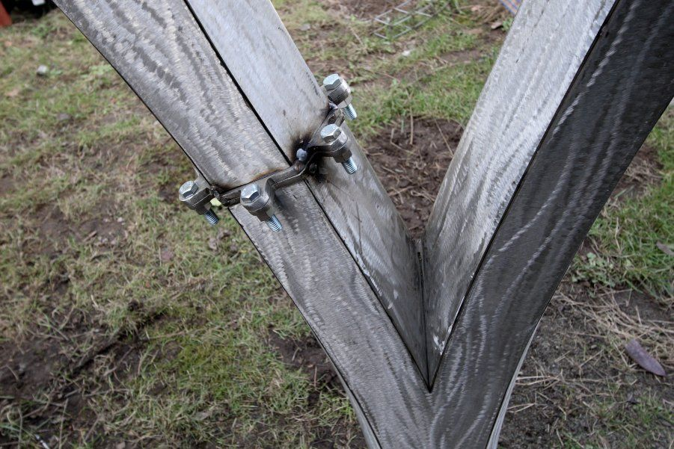
ARTIST’S PROTOTYPE

Slide 10
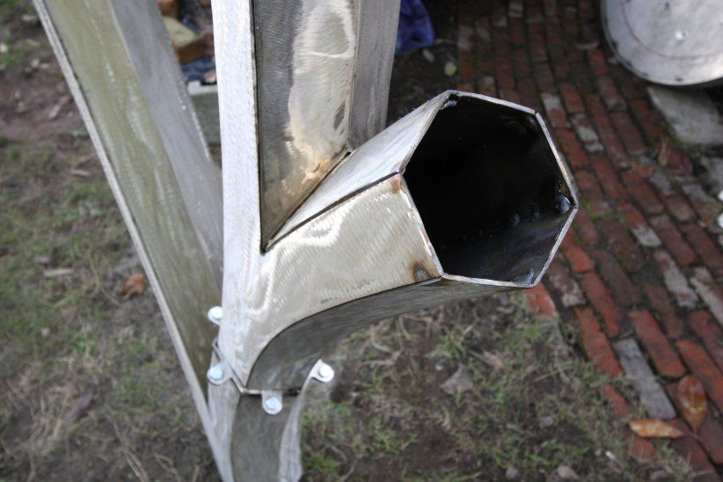
ARTIST’S PROTOTYPE

Slide 11
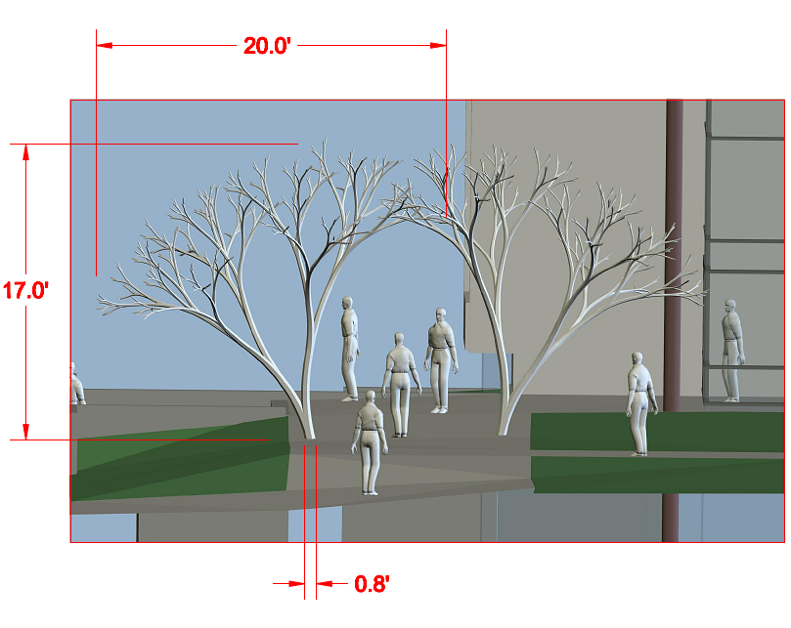
SCULPTURE RENDERING — ARTIST’S PROPOSAL

Slide 12
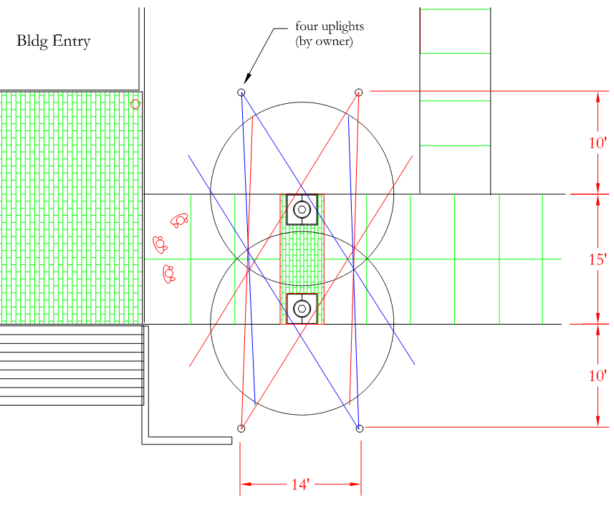
LIGHTING PLAN — ARTIST’S PROPOSAL

Slide 13
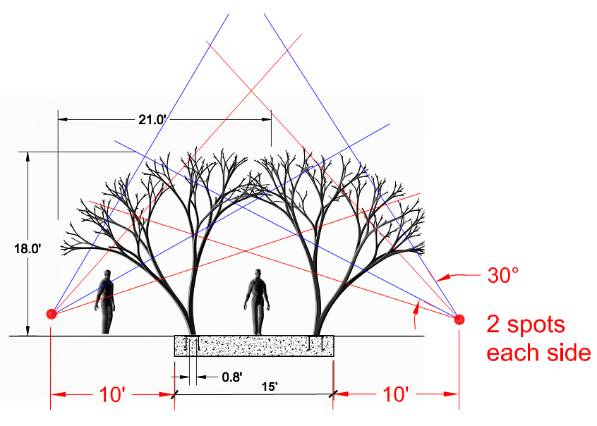
LIGHTING PLAN — ARTIST’S PROPOSAL

Slide 14
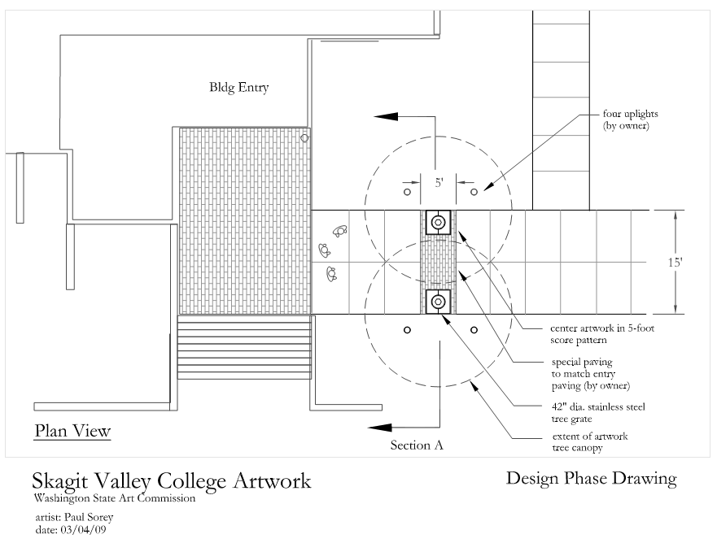
LIGHTING & LAYOUT — ARTIST’S PROPOSAL

Slide 15
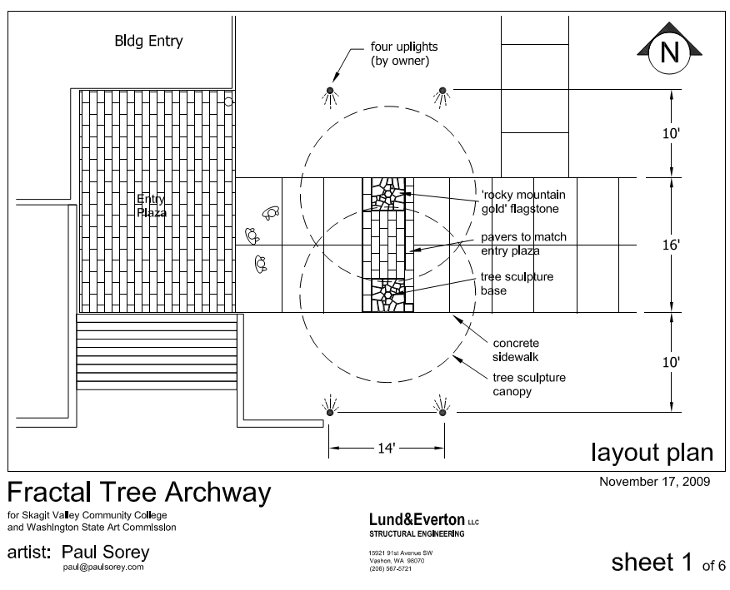
DRAWINGS FOR STRUCTURAL ENGINEERING — ARTIST’S PROPOSAL

Slide 16
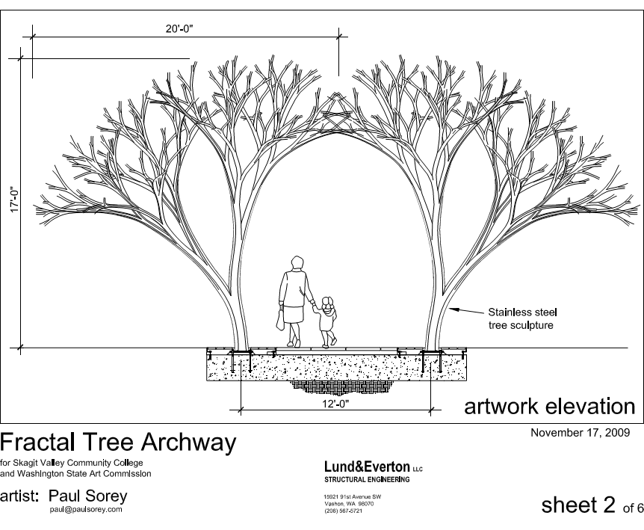
DRAWINGS FOR STRUCTURAL ENGINEERING — ARTIST’S PROPOSAL

Slide 17
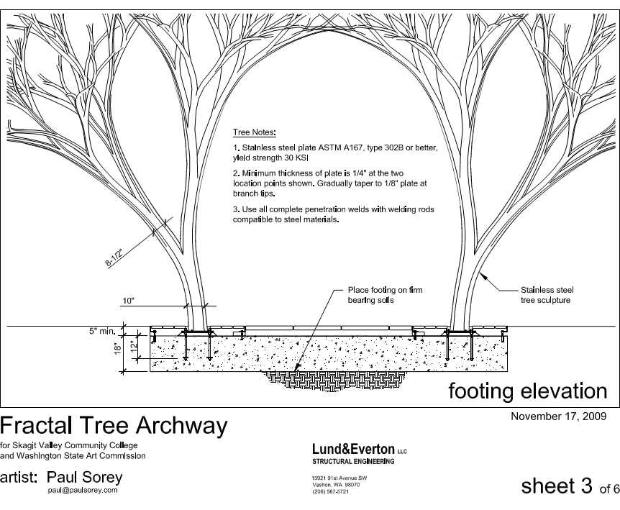
DRAWINGS FOR STRUCTURAL ENGINEERING — ARTIST’S PROPOSAL

Slide 18
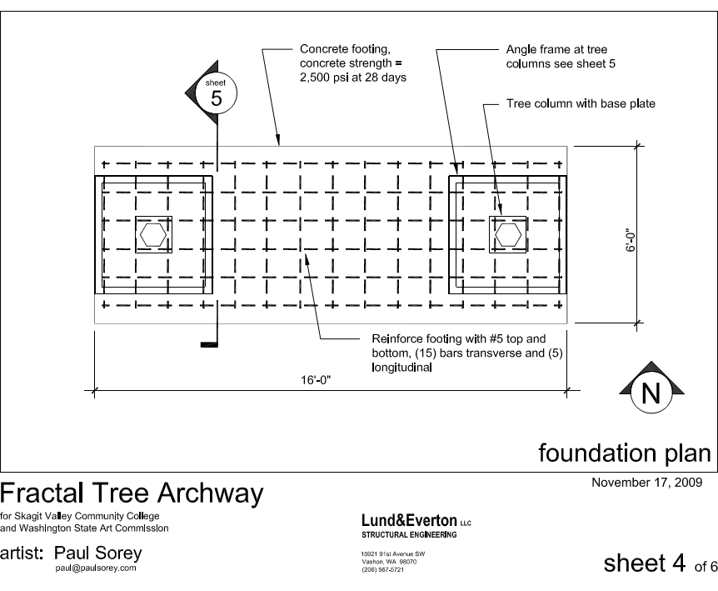
DRAWINGS FOR STRUCTURAL ENGINEERING — ARTIST’S PROPOSAL

Slide 19
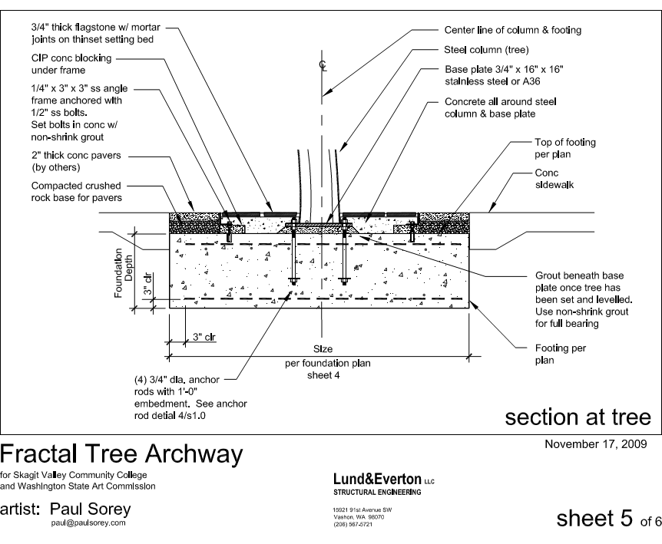
DRAWINGS FOR STRUCTURAL ENGINEERING — ARTIST’S PROPOSAL

Slide 20
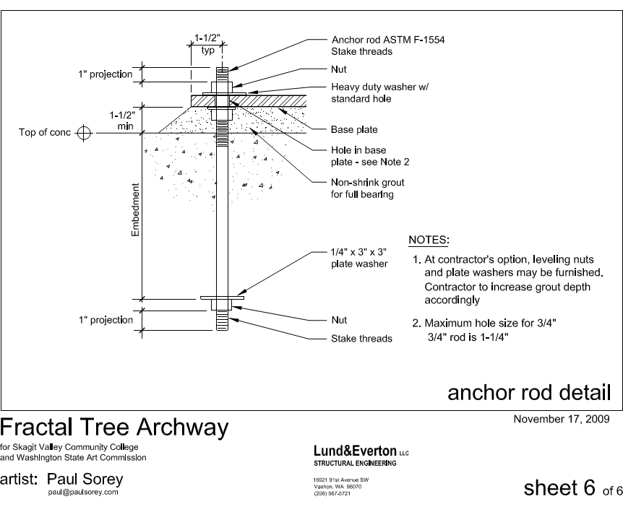
DRAWINGS FOR STRUCTURAL ENGINEERING — ARTIST’S PROPOSAL

Slide 21
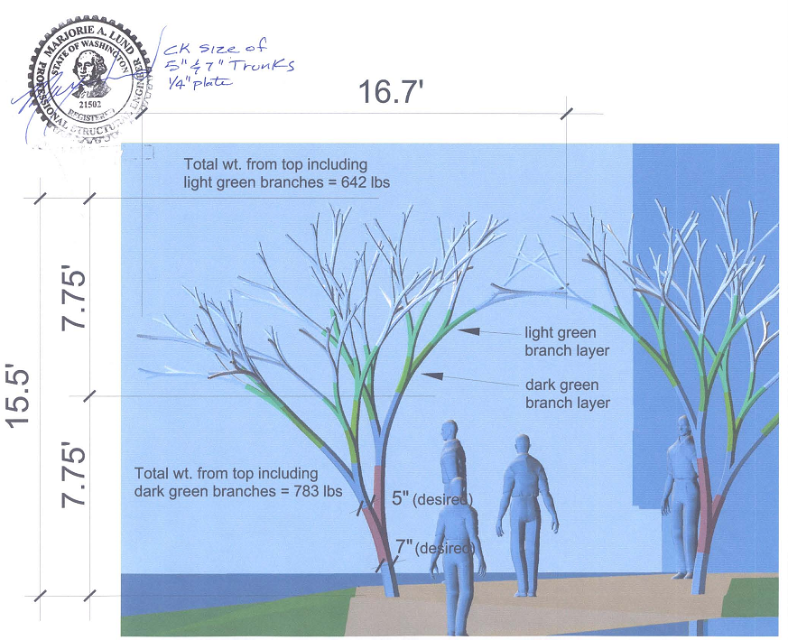
STRESS CALCULATIONS: COLORS INDICATE DIFFERENT AMOUNTS OF STRESS FROM WEIGHT
DRAWINGS FOR STRUCTURAL ENGINEERING — ARTIST’S PROPOSAL

Slide 22
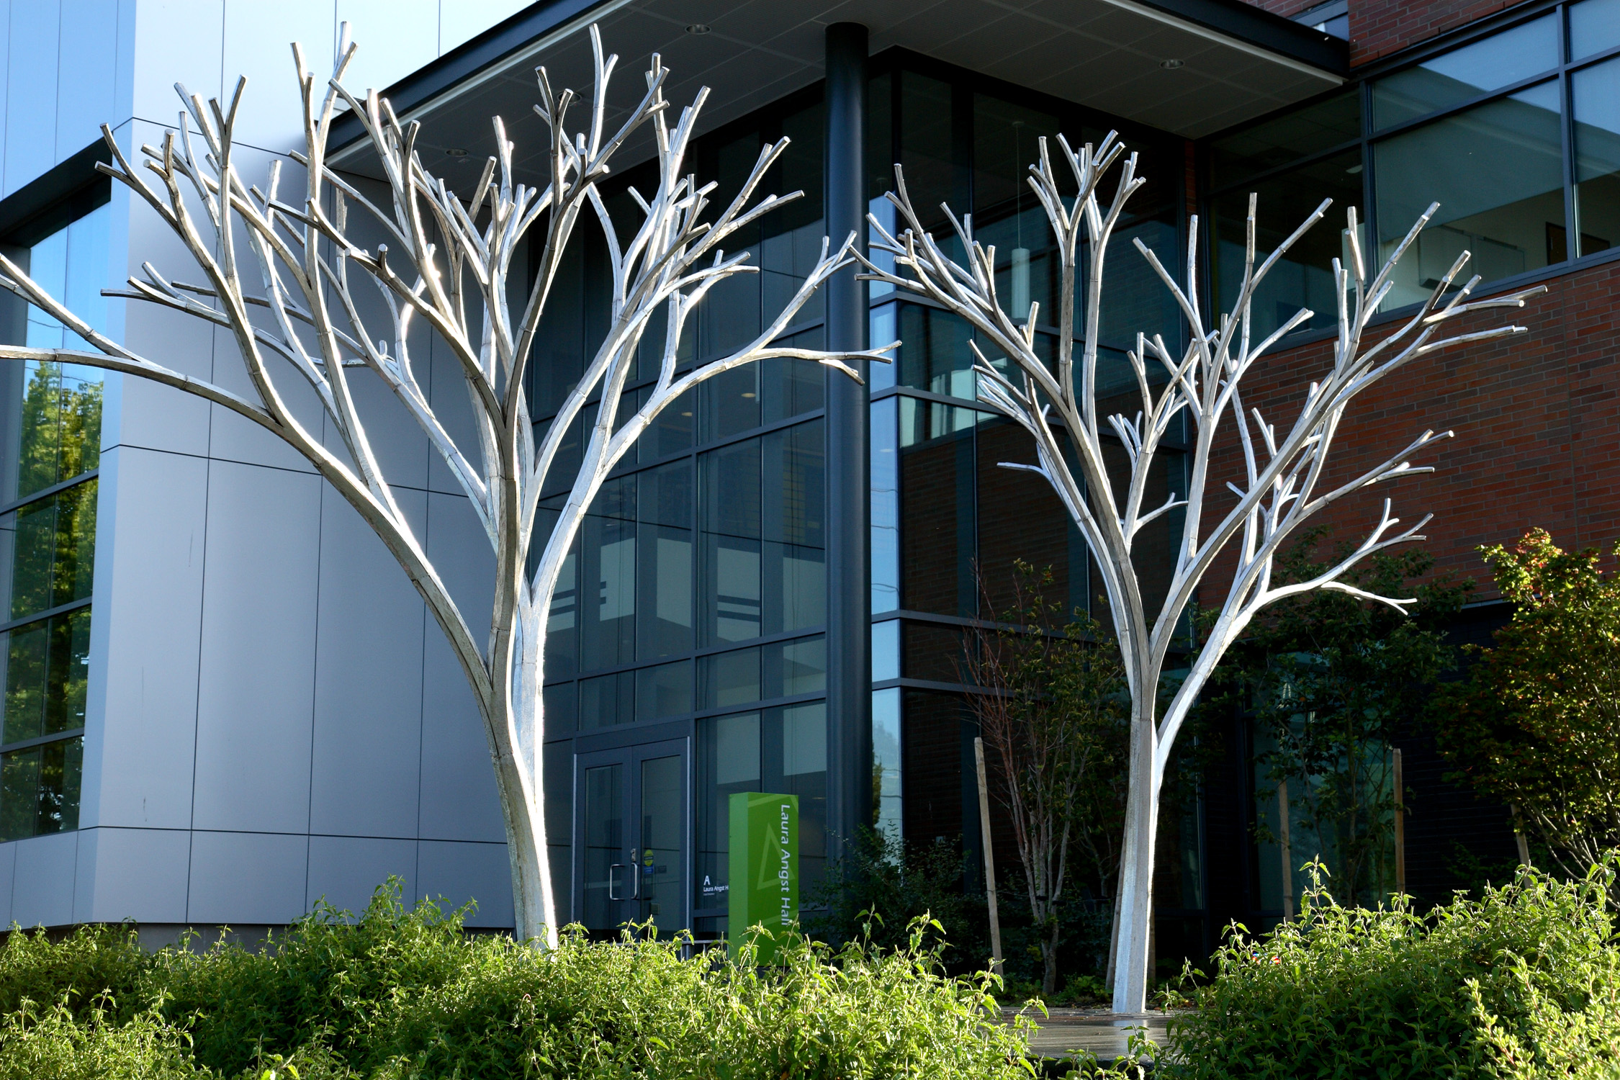
Notes:
Fractal Tree Archway, 2010, by Paul Sorey

Slide 23
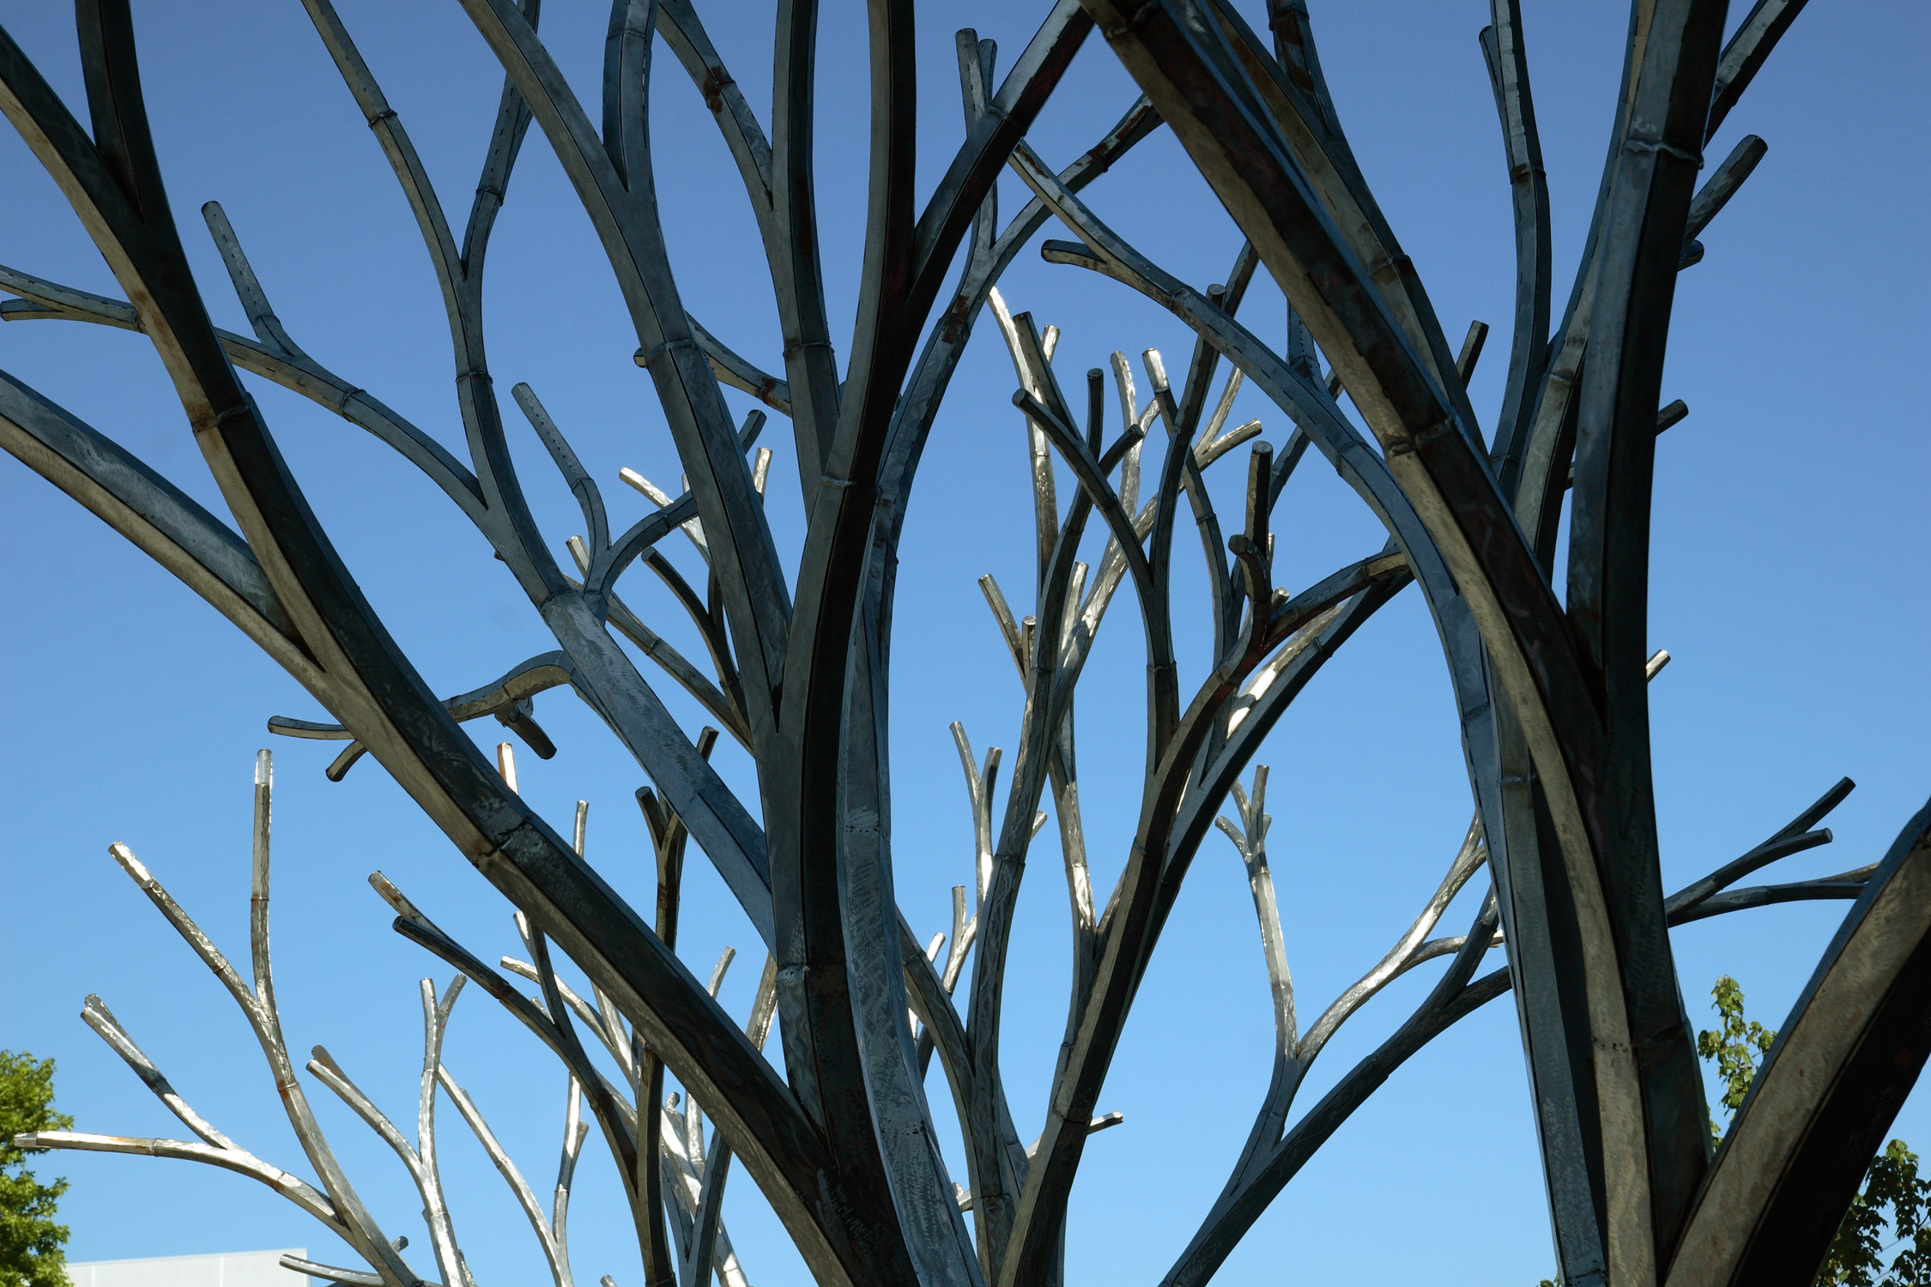

Slide 24
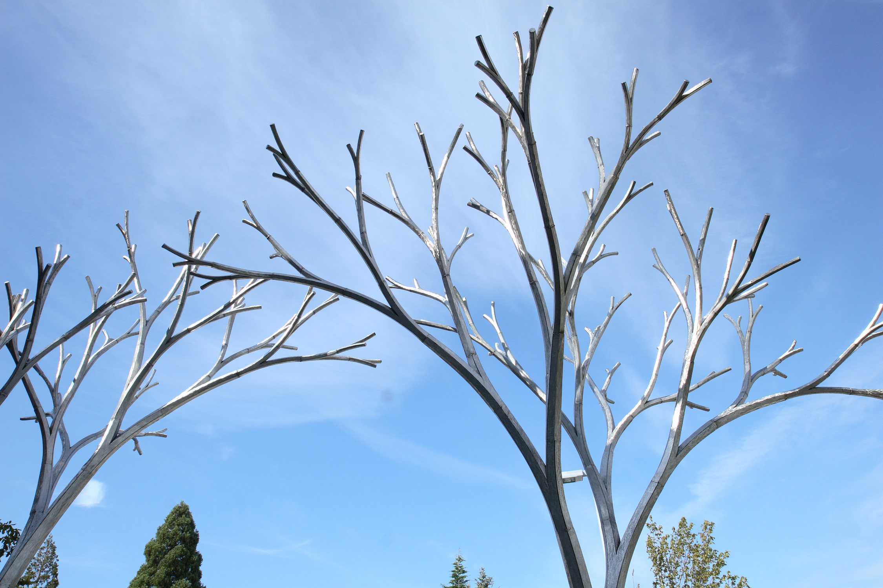
Notes:
Committee criteria for Paul Sorey’s Fractal Tree Archway:
Addresses environment
Something tall
Lyricism; nice play off minimal building
Community-gathering
Environmental & natural focus
Challenging — not provocative, but intellectually engaging
A signature work
Nice site lines to other campus buildings

Slide 25
Endless
Lead Pencil Studio

Slide 26
BCC Proposal description
Endless by Annie Han & Daniel Mihalyo
Concept:
Endless is an expression of the infinite possibility in the combinative nature of knowledge. Individual discoveries that might seem inconsequential or would suggest a dead end can be recombined to form a larger coherence within the constant state of research-driven metamorphosis. At any given moment, the world of science can be understood as a unified and accelerating progression that feeds our endless search for solutions to ever more complex problems.
The grid of columns suggests a rational portion of the new, existing and future structures within the campus environment where expansion is inevitable. It also expresses the organized framework within the science research, where efficiency and accuracy are the foundation. Within that framework is mysterious form expressed as a stair that seems to be simultaneously growing and disappearing. Depending on the position of the viewer, the staircase can be seen as either solid or void, referencing the endless shifts in perception and the importance of contradictory inquiry.
ARTWORK CONCEPT — ARTISTS’ PROPOSAL

Slide 27
Dimension:
The entire sculptural grid is 62 feet by 78 feet in plan, with 16 individual, 16-inch-square concrete columns in a 20- by 24-foot grid. Fourteen of the columns range from 2 to 7 feet in height, with two taller columns holding the staircase aloft at 35 ft in height. The entire length of the 9.5-ft-wide stair is 50 ft, with a 17-foot section missing at the lower base. It is made in welded stainless steel and blackened with a special oxidizing patina. There will be three light fixtures in a line and flush-mounted with the ground to up-light the stair section. A stainless steel plaque with etched text and dimension of 8 inches by 10 inches by 3/8 inch will be mounted on a short column near the pathway on route to the Science & Technology building (see aerial view).
Material & Finish:
Foundations: Two cast-in-place concrete foundations with Sono Tube forms
Concrete columns: Two coats of matte exterior-grade sealer (use graffiti sealer only if it becomes necessary)
Stair sculpture: 3/16-inch TIG-welded stainless steel(blackened with exterior rated chemical patina)
Light fixtures: Three exterior-grade, outdoor lights linked to the outdoor light timer system for the new building
Name plaque: 3/8-inch etched stainless-steel plate with black etched letters
ARTWORK SPECS — ARTISTS’ PROPOSAL

Slide 28
Installation technique:
Smaller pre-cast columns with integral footings will be placed on-site at specified locations. The two larger pre-cast columns will be placed on-site within Sono Tube foundation forms. The two stair sections will be attached to the two columns by TIG-welding the stairs to the embedded stainless-steel plates on the pre-cast columns at pre-determined locations. See provided detail drawings.
Anticipated routine maintenance:
General trimming of grass around the sculpture.
Picking out debris collected in the stair sections.
Graffiti removal and surface cleaning and spot-sealing as vandalism occurs.
All the light fixtures should receive a thorough cleaning during lamp replacement.
Anticipated special maintenance: Every 10 years
All columns to receive a power-washing and re-application of the exterior grade concrete sealer.
Critical column to stainless-steel weld joints should receive inspection for rust and weld degradation.
ARTWORK INSTALL AND MAINTENANCE — ARTISTS’ PROPOSAL

Slide 29
Timeline:
August 2007: Locate and coordinate exterior lighting and conduit with contractor and Miller/Hull.
August 2008: Check with Miller/ Hull construction schedule, get updates on overall project status.
September 2008: Proceed with engineer calculation and foundation design.
October 2008: Purchase materials and start fabrication for the stairs, and order pre-cast concrete columns.
November 2008: Check with construction schedule and coordinate site preparation including power to light locations and column locations.
November 2008: 50% completion on stair and columns.
December 2008: Continue on stair fabrication & coordinate with M/H site & landscape work.
January/ February 2009: Site work (digging column locations & possible placement of columns).
March 2009: All columns placed on site, finish stair fabrication
April 2009: Installation of stair on site.
May 2009: 100% completion.
Public event:
Artist talk in May: Artist talk at BCC — will coordinate time as it gets closer, possibly associated with the grand opening.
TIMELINE AND PUBLIC EVENT — ARTISTS’ PROPOSAL

Slide 30
BCC Budget
Category | Description | Amount
Materials & equipment Structure engineer Labor- artist Labor- assistant Studio Identification plaque Installation labor/ equipment Insurance Artist travel cost Delivery of artwork to site Installation per diem Public event Artist fee WA state tax Contingency & inflation | SS rods, pre-cast concrete, lighting & related equipment Consulting & stamped engineering calculation Fabrication of welded sculpture Concrete & site work Overhead costs rental space during production 3/8-inch etched stainless steel w/epoxy anchor Extra help and small crane service During fabrication & installation Site & shop visits Columns & sculpture delivery on flatbed Artist & crew meals during installation Presentation preparation & time for 1 BCC presentation Ideas, coordination & site visit for 2 persons On artist fee & labor Unforeseen costs & inflation | $40,000.00 $1,000.00 $9,000.00 $9,000.00 $3,000.00 $ 500.00 $5,000.00 $ 500.00 $ 500.00 $1,000.00 $ 420.00 $ 350.00 $8,000.00 $1,512.00 $7,000.00
Total | Artwork Budget | $86,782.00
FABRICATION BUDGET — ARTISTS’ PROPOSAL

Slide 31
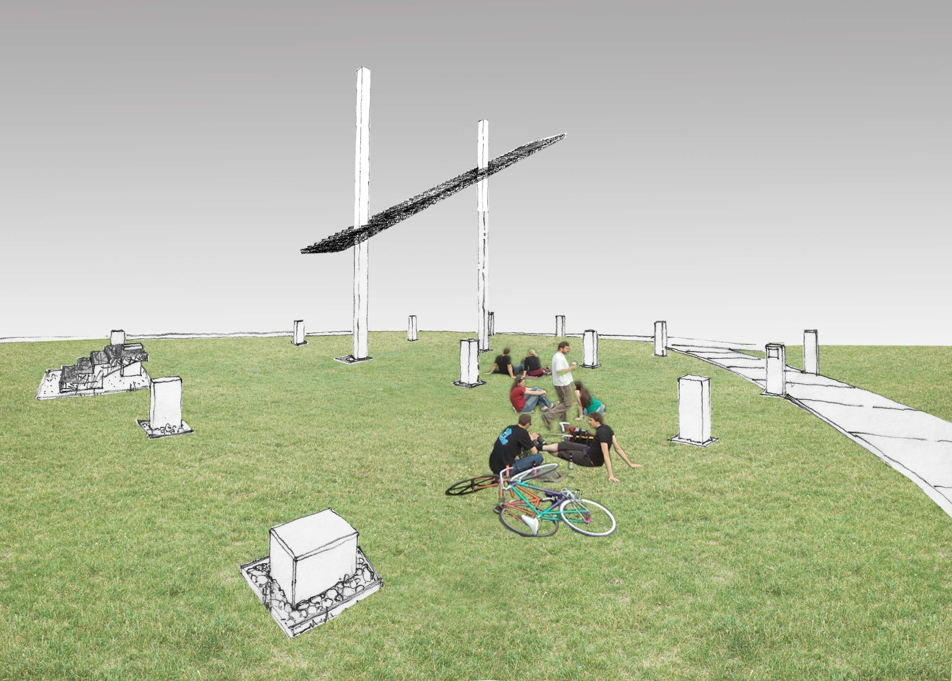
ARTISTS’ RENDERING

Slide 32
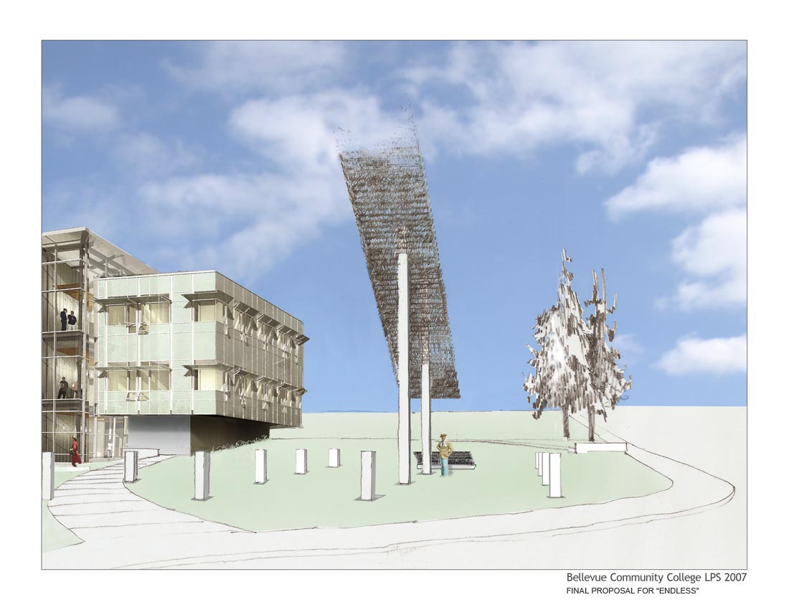
ARTISTS’ RENDERING

Slide 33
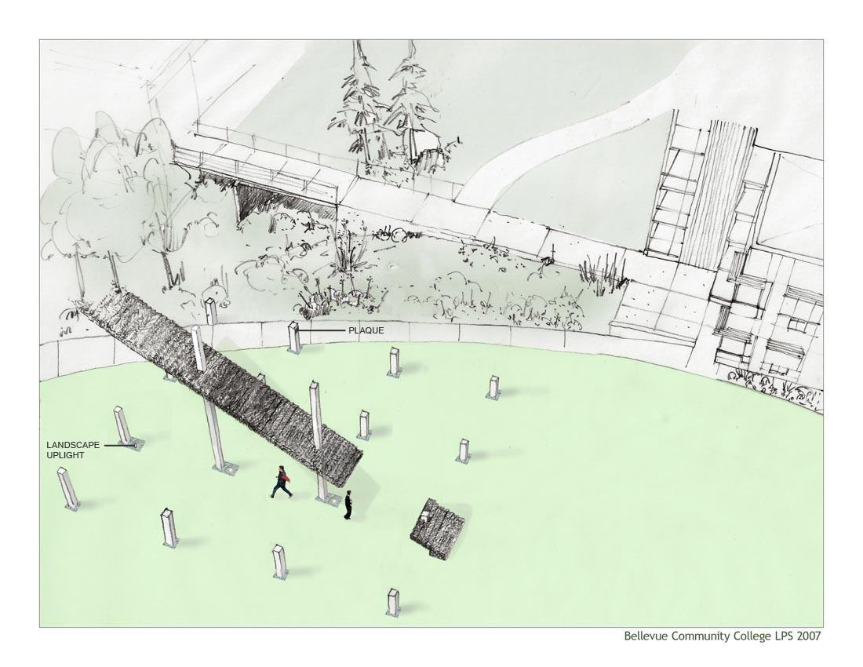
ARTISTS’ RENDERING

Slide 34
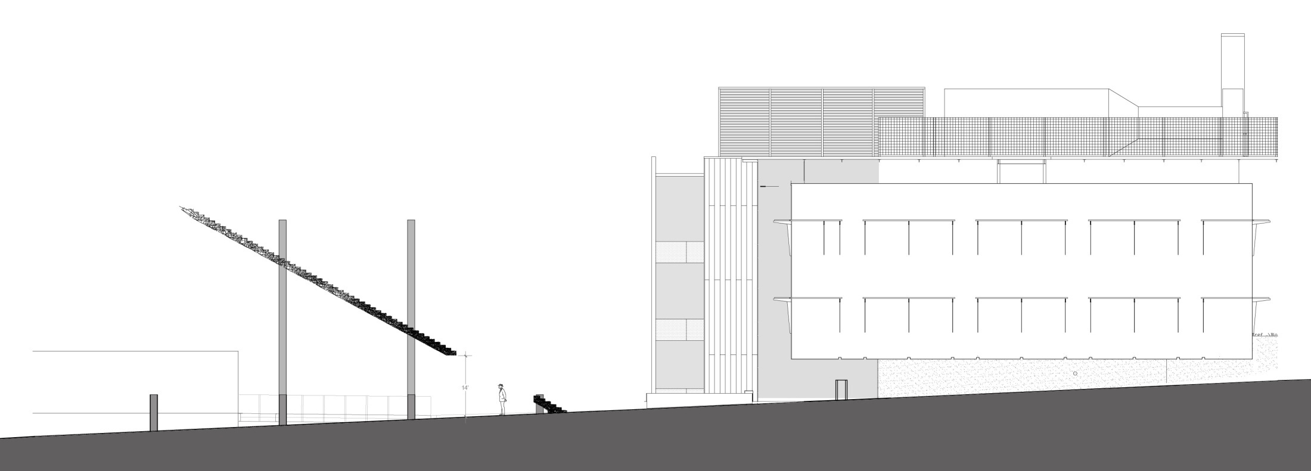
ARTISTS’ SCALE DRAWING

Slide 35
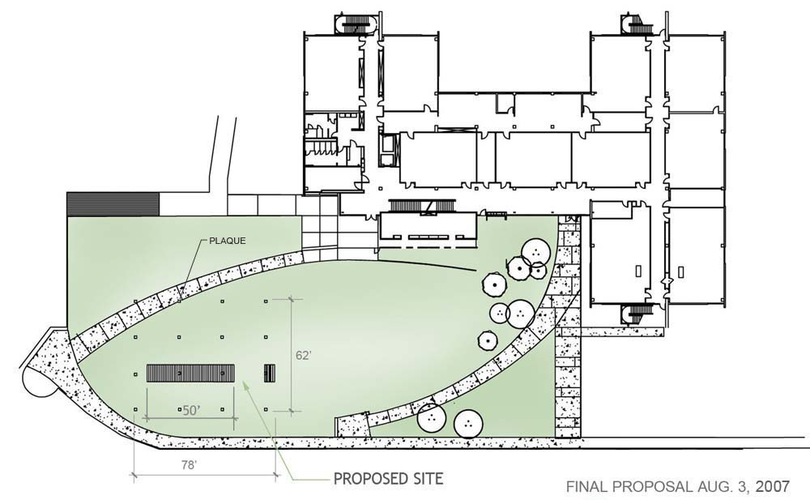
ARTISTS’ LAYOUT PLAN

Slide 36
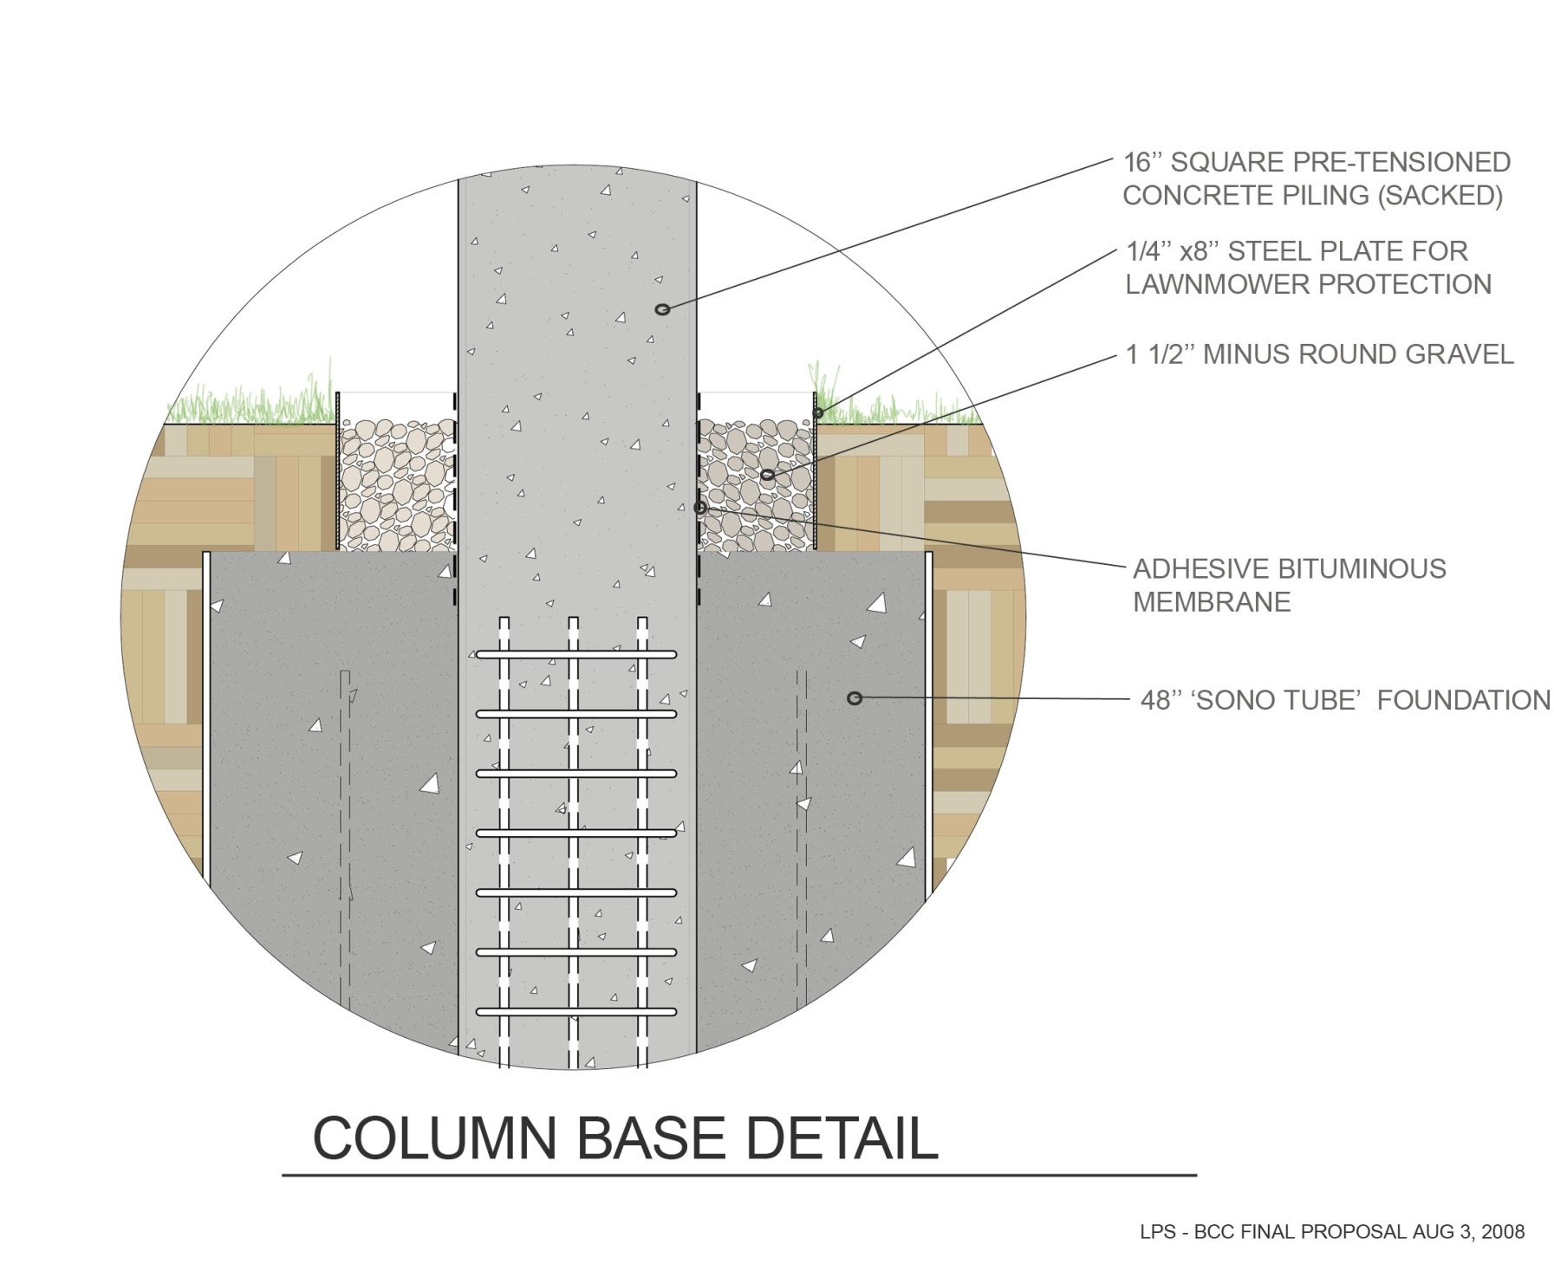
ARTISTS’ FOOTING/FOUNDATION PLAN — DETAIL VIEW

Slide 37
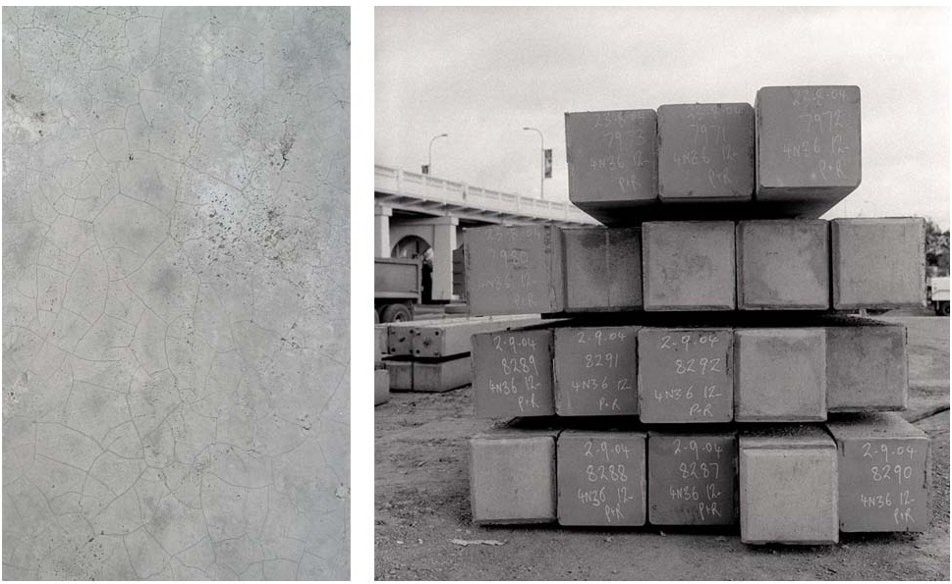
ARTWORK IN FABRICATION

Slide 38
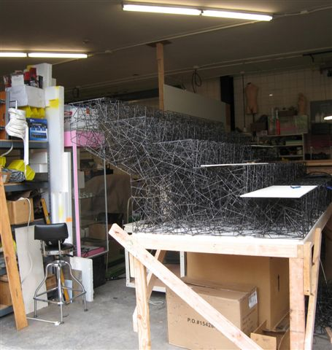
ARTWORK IN FABRICATION

Slide 39
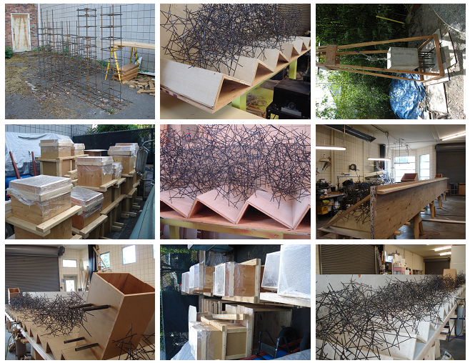
ARTWORK IN FABRICATION

Slide 40
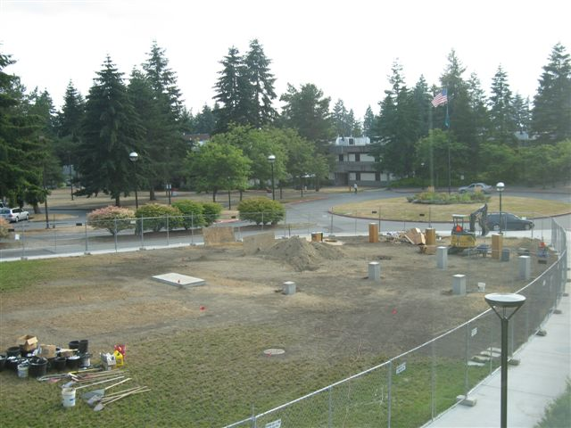
INSTALLATION PHOTOGRAPH

Slide 41
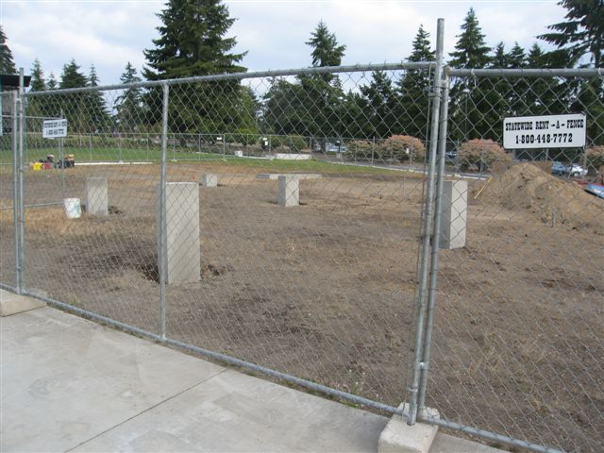
INSTALLATION PHOTOGRAPH

Slide 42
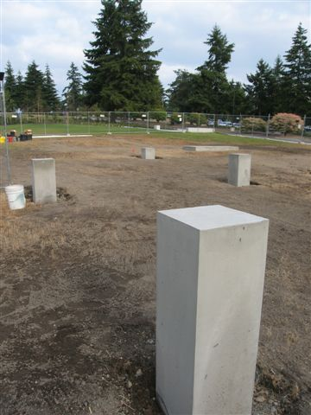
INSTALLATION PHOTOGRAPH

Slide 43
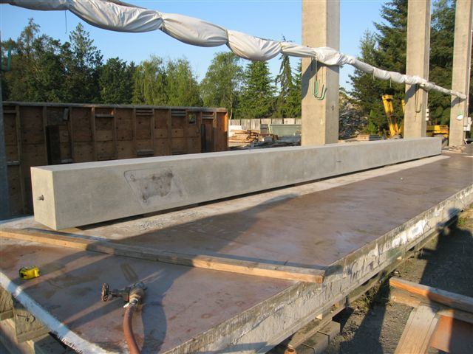
INSTALLATION PHOTOGRAPH

Slide 44
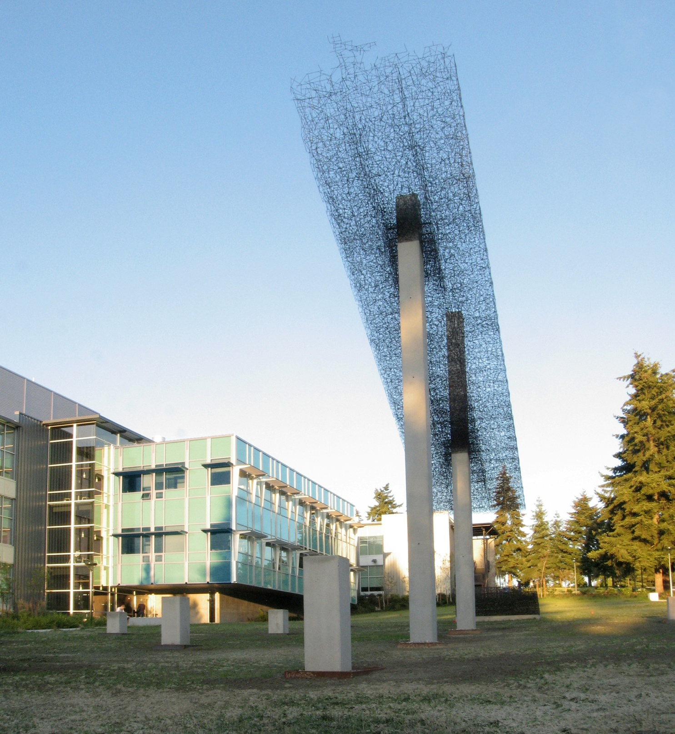
Notes:
Endless, 2009, Lead Pencil Studios
(Annie Han and Daniel Mihalyo)

Slide 45
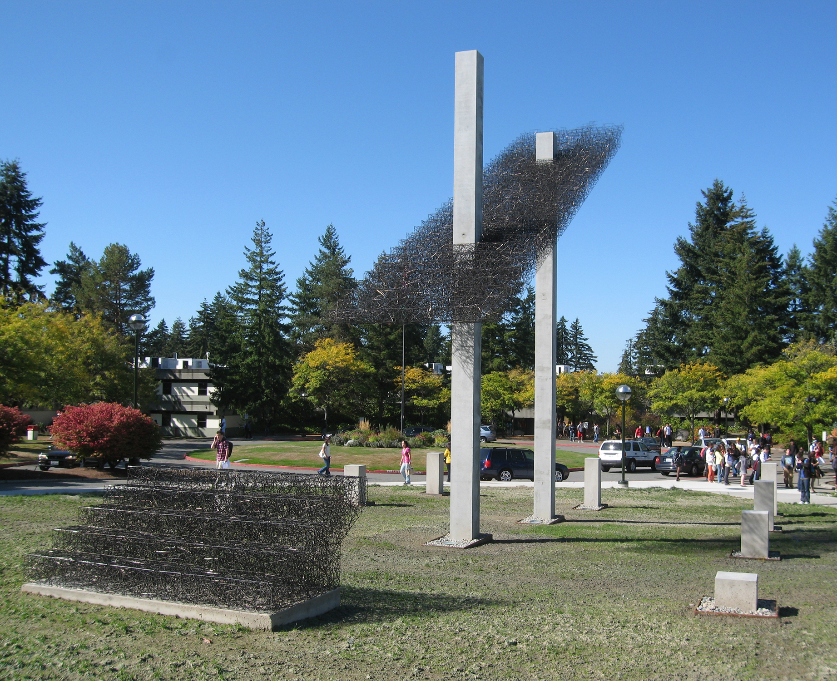

Slide 46
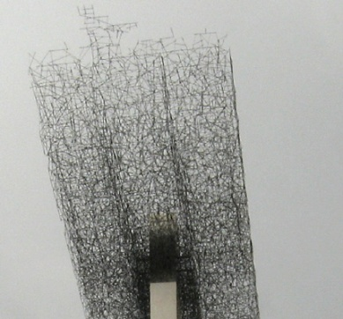
Notes:
Committee criteria for Lead Pencil Studio’s Endless:
Lightens/softens campus hardscape
Responds to the building design, experiential with space and/or interactive
More than decorative, causes discourse, visual connections of concept as teaching tool, stimulates curiosity and discussion (brain think / provocative)
Suggests/echoes science, multiplicity of readings /interpretations

